Slide 1
CERDEC ILIR 2013 Proposal
Optimal Path Selection based on QoS - Applied to Mobile Inter-Domain Routing
Bennie Blunt, Jr (S&TCD)

Slide 2
Problem Statement
Problem: To date the Army has not developed a routing architecture designed with Tactical networks in mind; there exists no exterior gateway protocol from the Internet community for mobile ad-hoc networks. The Army is in need of an exterior gateway protocol (EGP) that will work across all vendor platforms. The routing protocol must allow the war fighter to be mobile while maintaining connectivity from the dismount to the lower tactical internet, to upper tactical internet, and to applications on the WIN-T network. The protocol will need to address several areas such as security, QoS, scalability, adaptability, and energy consumption, to name a few. This research will focus on a purpose built protocol for Tactical networks leveraging QoS metrics in the route path selection. The state-of-the-art existing commercial Border Gateway Protocol version 4 (BGP4) is not designed for mobile networks nor does it support QoS based route selection.
Research Objective: “Optimal Route Path Selection in Mobile Inter-Domain Routing (MIDR) leveraging QoS“
Develop a viable QoS route selection algorithm that is applicable to the tactical environments
Create code for a pseudo optimal route path selection algorithm that is portable and can be leveraged in work being done by the QUEST Program.
Create a working model/simulation for validation.

Slide 3
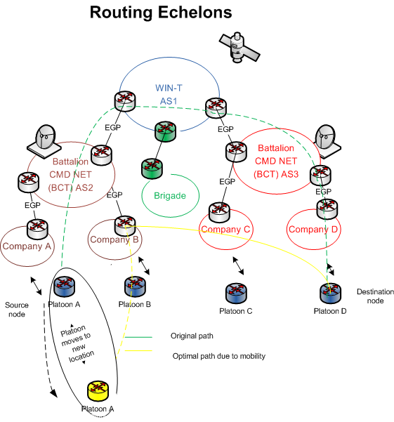
Mobile Inter-Domain Routing Optimal Route Selection based on QoS
Research Objectives:
All inter-domain routing protocols perform basic route selection based upon simple (AS) hop-count. While suitable for stationary networks, It is a huge problem for the Tactical networks where bandwidth may range from 225k bps to 25Mbps and the networks are mobile
Incorporate static metrics (BW, delay, loss) for improved route path selection
In future incorporate load based dynamic metrics for even more optimal route path selection
Expected Results:
An algorithm that is applicable to a mobile inter-domain routing (MIDR) protocol developed in QUEST
Construct a mathematical model
Develop a route selection algorithm
Model/simulate the algorithm
Shared test results
Relevance to Army:
Contribute to a routing protocol that is designed specifically for the mobile connectivity between WIN-T, Upper Tactical Internet (UTI), and Lower Tactical Internet (LTI)
Mobile routing and connectivity between the LTI, UTI and the WIN-T backbone
Next Steps:
Select metrics in collaboration with routing IPT
Develop method to incorporate metrics into the algorithm
Research Schedule & Cost
Research Tasks | FY13 | FY14 | 1st Year | 2nd Year
Algorithm Research |  |  | 75k
Modeling & Simulation |  |  | 75k | 75k
Testing |  |  |  | 50k
Specification |  |  |  | 25k
Totals |  |  | 150k | 150k

Slide 4
Research motivation
Known problem within the Army Tactical Networks:
Recent participation in Annex Development of Routing and QOS on behalf of CIO/G6 for the Network Integrated Evaluation, and
Recent participation on Routing IPT.
This research lends itself readily for transition into QUEST and will directly contribute to their current research in Mobile Inter-Domain Routing.
In addition, literature review and recent courses in Wireless Engineering and Wireless Ad Hoc & Sensor Networks indicate that research in this field is slight.
This ILIR is related to part of my planned PhD thesis projected to start at Missouri S&T Spring 2013.

Slide 5
References
1. Masip-Bruin X, Yannuzzi M, Domingo-Pascual J, et al. Research challenges in QoS routing. Computer Communications. 2006;29:563-581.
2. Li Xiao, Jun Wang, King-Shan Lui, K. Nahrstedt. Advertising interdomain QoS routing information. IEEE Journal on Selected Areas in Communications. 2004;22:1949.
3. Norden S. Inter-domain routing: Algorithms for QoS guarantees. Computer Networks. 2005;49:593-619.
4. Mellouk A, Zeadally S, Mueller P. Foreword: Routing and QoS over heterogeneous networks. annals of telecommunications - annales des télécommunications. 2008;63:543-544.
5. Griffin D, David Griffin, Spencer J, et al. Interdomain routing through QoS-class planes [Quality-of-Service-Based Routing Algorithms for Heterogeneous Networks]. IEEE Communications Magazine. 2007;45:88-95.
6. Mellouk A, Hoceïni S, Zeadally S. Design and performance analysis of an inductive QoS routing algorithm. Computer Communications. 2009;32:1371-1376.
7. Li Xiao, Jun Wang, King-Shan Lui, K. Nahrstedt. Advertising interdomain QoS routing information. IEEE Journal on Selected Areas in Communications. 2004;22:1949.
8. Yang K, Wu Y, Chen H. QoS-aware routing in emerging heterogeneous wireless networks[Quality-of-Service-Based Routing Algorithms for Heterogeneous Networks]. IEEE Communications Magazine. 2007;45:74-80.
9. CUI Yong, ZHAO YouJian, KORKMAZ Turgay& ZHANG TieLei. Supporting multiple metrics in QoS-aware BGP. SCIENCE CHINA, Information Sciences. October 2010 Vol. 53 No. 10: 1947–1962

